Slide 1
ACCE MARKETING TRAINING & ROUNDTABLES Ambassadors, Peers & Liaisons February 2019

Slide 2
Purpose for Training
Define roles of ambassador, peer and liaison
Discuss strategic marketing initiatives progress – Susan
Develop consistent language using key messages
Provide introduction to collateral materials created specifically to support outreach activities
Discuss other means to expand ACCE brand and accreditation value

Slide 3
Jump Drive Contents
Jump drives
Thank you notes
Contact cards
Brand/style guide
Blank PPT templates
Key messages tool
Training slides
Advantages of Accreditation print collateral piece
Advantages of Accreditation slides
Process/procedures collateral piece
Overview of Outcomes Based Assessment – focus on Curriculum, academic quality improvement and outcomes sections
Overview of advantages and value of outcomes based accreditation versus process based.
National association calendar.

Slide 4
Volunteers & Staff

Slide 5
Ambassadors – ACCE advocates & members who promote externally to academics, industry and associations
Liaisons – ACCE constituents who share happenings from their group with ACCE for purposes of promotion externally
Peers – individuals who promote to others who hold similar positions at other institutions, associations or companies
ACCE Staff – outreach from staff to all audiences via numerous outlets

Slide 6
Purpose for Volunteers
The volunteer roles were developed out of the need to support external marketing and development.
The goals of the volunteer program are to:
Build an expanding base of accredited programs
Increase ACCE brand awareness
Develop and support communication strategies around social media, newsletters, website and emails
Grow membership across all categories
Increase sponsorship income
Support Staff communication responsibilities

Slide 7
Ambassadors & Peers

Slide 8
Brand Ambassadors
Brand ambassadors provide a face for an organization within a community of people with whom they have established trust. They represent the values of your brand to constituents, and empower you to spread the word about your brand to potential partners and accreditation candidates without having to using in-your-face sales/fundraising tactics.
Characteristics:
Knowledge of & appreciation for ACCE outreach
Established online presence
Professionalism/recognition within sphere of influence
Leadership skills
Passion for building and nurturing relationships built on trust
Ability to gather feedback & provide insight

Slide 9
Successful Ambassador Program
According to a Forbes article written by Kate Harrison, published Oct. 16, 2017 a successful brand ambassador program will:
Select ambassadors based on users (prospects, members)
Have a process for securing volunteers (builds stronger commitment)
Understand the ambassador’s goals
Draft an ambassador plan
Trust and transparency
Have an open channel for feedback and praise
Track success

Slide 10
In order to build trust and a sense of belonging, you need to add ongoing updates about the company’s progress and upcoming releases as part of your communication plan. Ambassadors need to feel they’re part of your brand’s journey. Brand evangelists must feel they are collaborating directly with those they are representing. This is not the place to use an anonymous blanket newsletter sent to thousands. When you’re communicating with an external community, such as your brand ambassadors or partner groups, the content must be highly personal.
Sharon Savariego, CEO and co-founder of Mobilize

Slide 11
ACCE Ambassadors
What will an ACCE ambassador do?
Promote the advantages of ACCE accreditation using print collateral or by giving presentations.
Give formal presentations at industry or academic meetings (National association calendar available).
(Peers) will give one-on-one or small group presentations to those in similar roles at institutions or in IABs.
Discuss experience with ACCE accreditation, mentoring, visiting teams and processes.

Slide 12
ACCE Ambassadors
Encourage associations, institutions and industry professionals to become Council supporters through membership, sponsorship and participation in ACCE. Carry membership forms when meeting with people, or email membership form following a discussion.
Encourage contacts to become involved in programs, committees, training or accreditation visits. Provide calendar of ACCE events.
Distribute, by mail or email, information about ACCE.
Request contact information and permission to add to ACCE contact database.

Slide 13
Attendee Experiences
Has anyone in attendance today given a presentation to an academic or industry association?
Had you done it before?
What tools did you use to aid in the presentation?
What did you cover during your presentation?
What questions/topics were brought up others in the room?
What were the results? Any follow-up interaction?

Slide 14
How is a Peer Different?
Peer relationships are generally more personal and therefore because of the nature of the relationship and size of meeting (typically less than 2-3) a discussion is forming rather than a presentation.
Storytelling – relay how ACCE has created an opportunity or solved a problem
Trust building – consensus and validation (they will talk to others)
Alignment – tailor information and track through database
Efficacy – incorporate the constituent’s or program’s POV into a customized presentation or discussion
Enablement – work collectively as volunteer and staff to understand the unique situation

Slide 15
Customization of Key Messages

Slide 16
Fundamentals of ACCE Communications
Tagline
Partnership for construction education excellence.
About ACCE
Promoting quality construction education since 1974, ACCE is the accrediting body that raises the standard of excellence for construction education through industry and academic partnerships.
Value Proposition
The American Council for Construction Education creates value for student, academic, industry and association stakeholders by:
 promoting rigorous accreditation;
 facilitating opportunities for networking, development and innovation;
 sharing best practices and benchmarking; and
 engaging academic and industry thought leaders.
Existing Mission Statement
To be the leading global advocate of quality construction education, and to promote, support and accredit quality construction programs.

Slide 17
Customization
Know your audience
Demographic composition
Vernacular
Familiarity with ACCE
Familiarity with other accrediting bodies
Prepare to present on specific topic – don’t be afraid to ask
Spend time on introductions
Be prepared to divert from presentation content
Call to action
Follow-up

Slide 18
Liaisons

Slide 19
Defining the Liaison Role
A person who establishes and maintains communication for mutual understanding and cooperation. merriam-webster.com

Slide 20
Liaison Objectives
Promote accredited programs
Promote ACCE through social media, digital news, social networking
Provide content for consistent, frequent newsletters and ACCE outreach programs
Support staff by providing timely, relevant, newsworthy and graphically appealing content or ideas

Slide 21
Understanding the Need
Among the ACCE strategic marketing initiatives goals is to create a more robust communication program.
“Liaisons” become field reporters:
Photography or video from competitions, IAB meetings, conferences site visits, labs so on and so forth’
Informal press releases from programs ie published papers, faculty news, student news;
Industry information from associations or IAB members; and
Quotes/testimonials

Slide 22
Understanding the complexity of a communication matrix

Slide 23
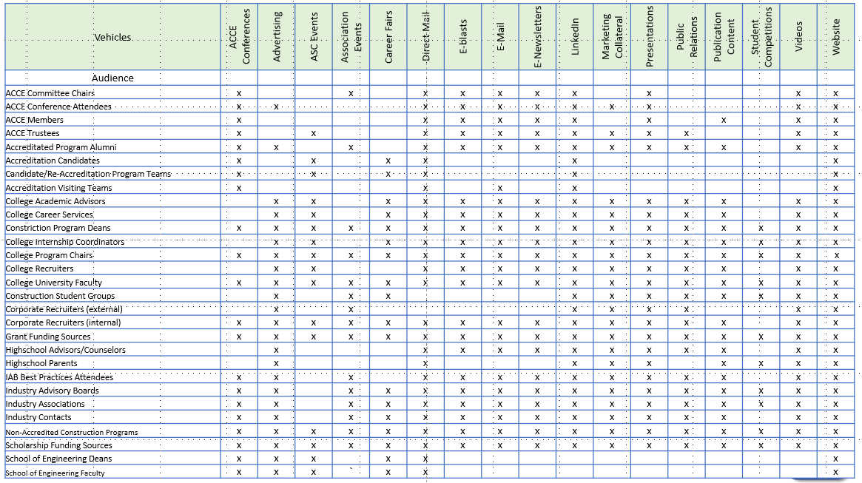

Slide 24
ACCE Activity
What would you like to know about ACCE member and accredited programs’ activity?
In what format?
How frequently?
How can ACCE grow its social media presence?
How will additional communication positively impact your roles as ambassador, peer or liaison?

Slide 25
Consent of Use

Slide 26
Thank you for your attention. Are there any Questions in the Room.

Slide 28
Five Contacts

Slide 29
Five Opportunities to Promote ACCE & Why

Slide 30
Five Pieces of Collateral & How You’ll Use Them

Slide 31
Five Reasons What You Do As A Volunteer Will Contribute to ACCE’s Success

Slide 32
Roundtable Discussions

Slide 33
Find a table with one of the following three topics: IAB Organizational Benefits Presentation Discussion Topics Include (but are not limited to): Explaining benefits of ACCE involvement. Benefits of ACCE membership. How to discuss ACCE fundraising with Deans and Program Chairs who are protective of their IAB members’ funding support. Presentations to Associations Discussion Topics Include (but are not limited to): Giving a presentation to a regional or national academic association – discussing the advantages of accreditation. Giving a presentation to a regional or national professional trade association. Key messages for diverse audiences. Membership Recruiting Discussion Topics Include (but are not limited to): Explaining the benefits of Association support and involvement. How financial support benefits the association. What membership includes. Explaining the membership tiers.
Attendees should select which general topic area is of interest to them.
Each table shall elect a facilitator and scribe & one or more individuals to present.
The scribe reporting form will be distributed to each table. − Use space provided.
Please hand notes in when complete so that the Marketing Committee understands where assistance is needed.

