Slide 1
Advantages of Accreditation

Slide 4
TRANSITION HEADLINE
Let’s start with the first set of slides

Slide 5
Quotations are commonly printed as a means of inspiration and to invoke philosophical thoughts from the reader.

Slide 6
This Is A Slide Title

Slide 8
You Can Also Split Your Content

Slide 9
In Two Or Three Columns

Slide 10

A complex idea can be conveyed with just a single still image, namely making it possible to absorb large amounts of data quickly.

Slide 11
White
Gray
Black

Slide 12
Table To Compare Data
 | A | B | C
Yellow | 10 | 20 | 7
Blue | 30 | 15 | 10
Orange | 5 | 24 | 16

Slide 13
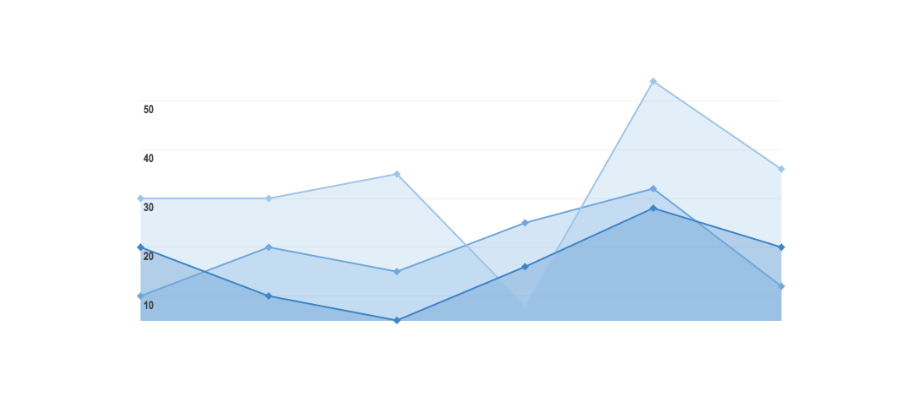
GRAPH TITLE

Slide 14
THANKS!
Any questions?
You can find me at
@username & user@mail.me

Slide 15
Credits

Slide 16
Presentation Design

